Slide 1
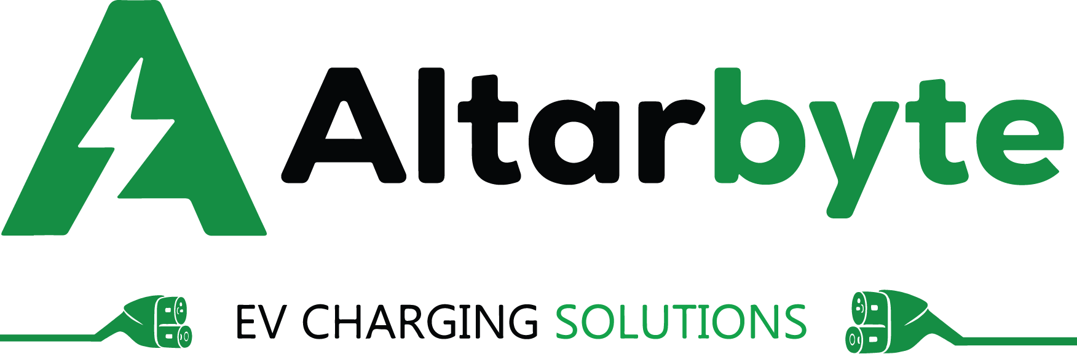
Email: altarbytei@gmail.com Website: https://www.altarbyte.com
Company Address: T-Hub Plot No 1/C, Sy No 83/1, Raidurgam, Knowledge City Rd,
panmaktha, Hyderabad, Serilingampalle (M), Telangana 500032
Driving The Future Of Sustainable Mobility
Founded with a vision to revolutionize India's transportation ecosystem, Altarbyte is building the country's most comprehensive and intelligent EV charging infrastructure.
We understand that the transition to electric mobility requires more than just hardware—it demands a complete ecosystem of smart software, reliable support, and seamless user experiences.
Our team of passionate engineers, designers, and sustainability advocates work tirelessly to make EV charging as natural as refueling has been for generations.
www.altarbyte.com T-HUB Hyderabad ,Telangana

Slide 2

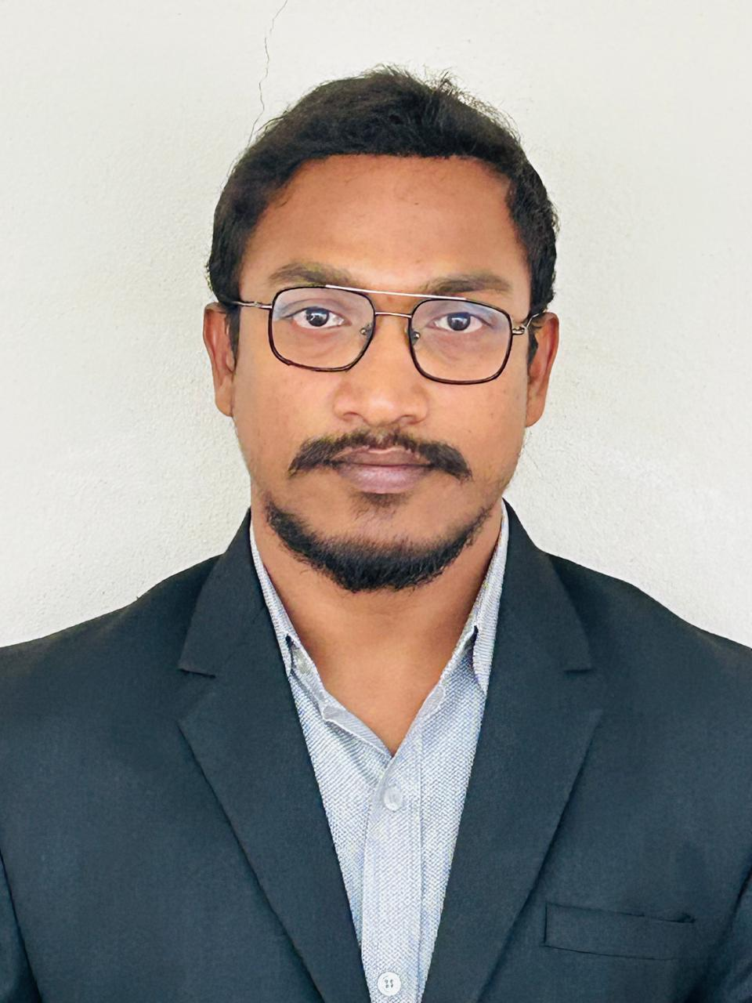
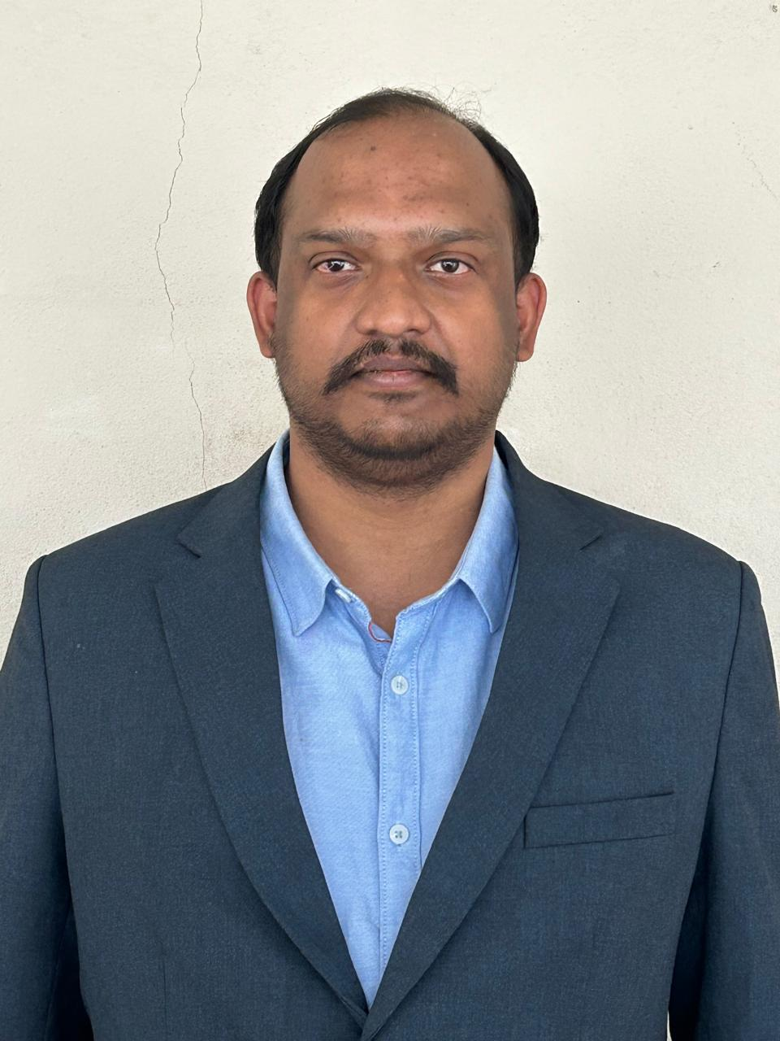
Meet The Team
Anvesh Thodupunuri
Founder & CEO
Visionary leader driving India's EV revolution with a mission to make sustainable mobility accessible to all.
With over 5 years of experience in clean energy and technology, Anvesh founded Altarbyte to accelerate the transition to electric transportation.
Ayyangar Satalluri
Co-founder & CTO
Technology innovator with deep expertise in IoT, embedded systems, and cloud infrastructure.
Ayyangar leads the engineering vision at Altarbyte, building the intelligent systems that power our nationwide charging network.

Slide 3
End-to-End EV Charger Setup & Support
From initial consultation to ongoing maintenance, we handle everything so you can focus on what matters most.
01 Free Site Assessment
We cover end-to-end site planning and branding to get your charging locations deployment-ready.
02 Execution Plan & Pricing
From hardware recommendations & pricing, to a full installation plan, we've got you covered.
03 Charger Installation
Our certified technicians install the charger(s) and test them for safety and compliance.
04 Onboarding & Activation
We complete your KYC, onboard you to Altarbyte, and activate your chargers with CMS dashboard access.
05 Service & Maintenance
Regular on-site health checks, software updates, and proactive issue resolution.
06 24/7 Customer Support
Our support team is available 24/7 to assist with technical queries or user concerns.
ALTARBYTE T-HUB Hyderabad,Telangana

Slide 4
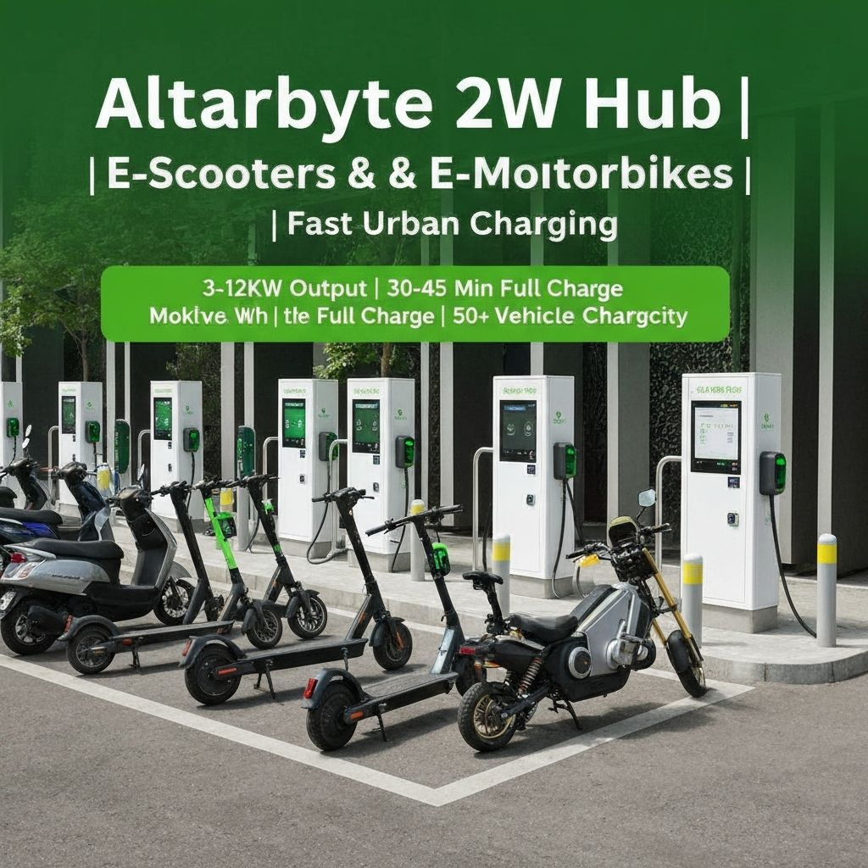
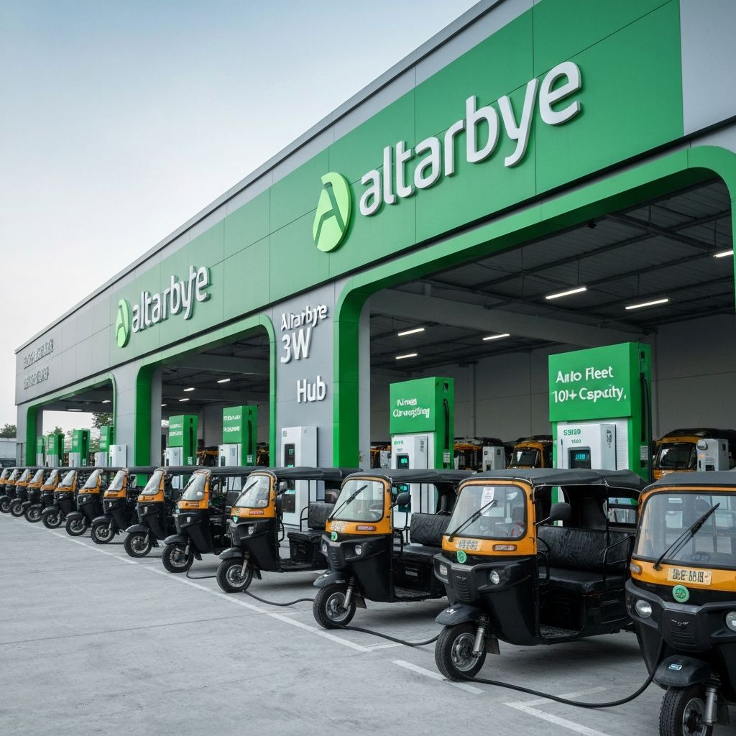
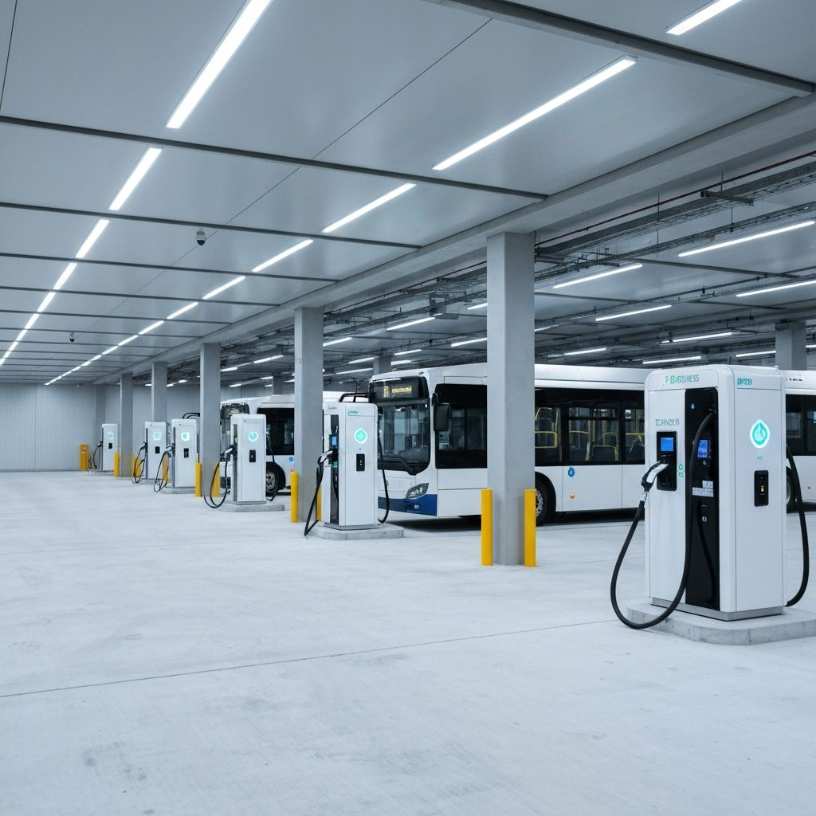
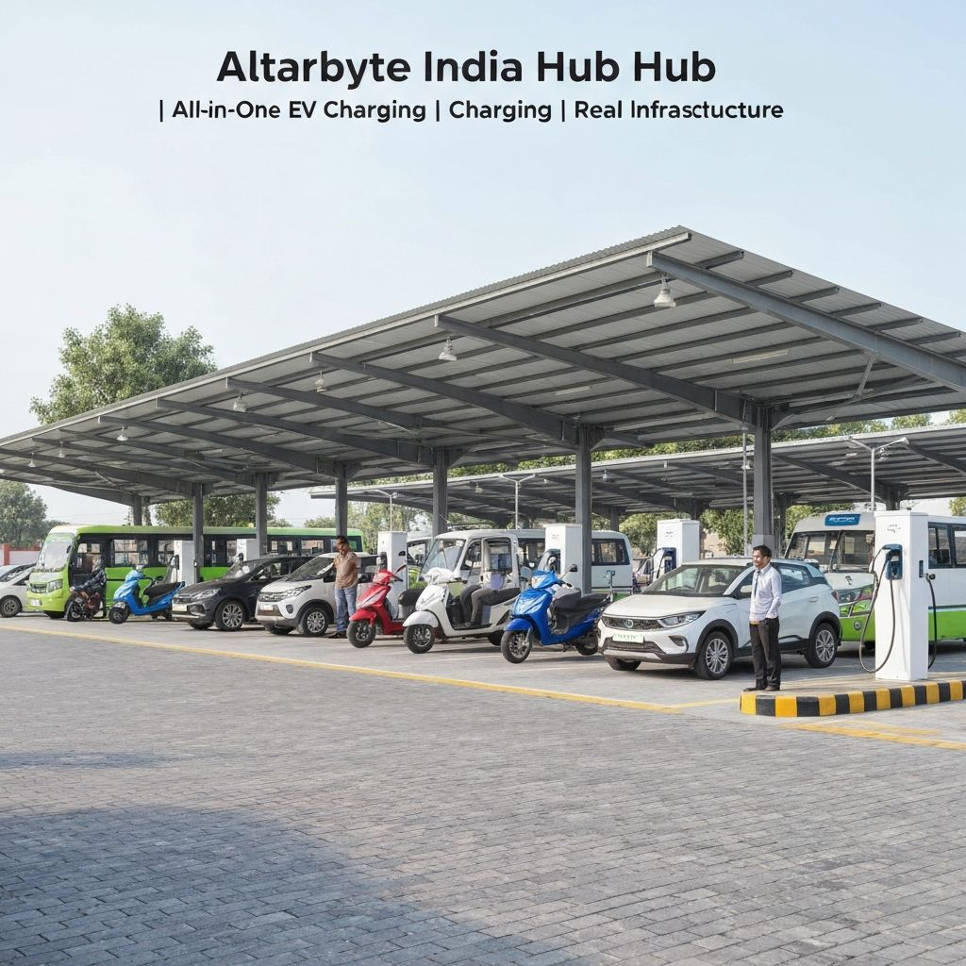

ALTARBYTE
Two wheeler chargers (AC, DC fast chargers)
Three wheelers chargers ( AC, DC fast chargers)
Four Wheeler chargers (AC, DC fast chargers)
Bus & Commercial fleet ( DC fast chargers)
ALTARBYTE T-HUB Hyderabad Telangana

Slide 5
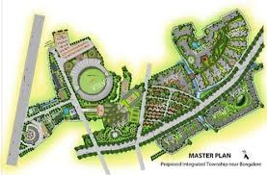
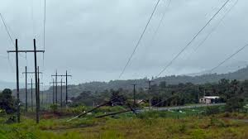


ALTARBYTE
Requirements to setup EV charging station/Hub
Electricity
Water
Investment
Land (Rent/Lease/Own)
ALTARBYTE T-HUB Hyderabad Telangana

Slide 6
Revenue Model
B2B
Commercial Buildings
B2C
Corporate Offices
Direct Sales
Highways & Fuel Stations
CPO & Dealers
Charge point Operators
Fleet Operators
Malls & Retail
Parking Operators
Public Charging Networks
Residential Communities
Dealership and partners
Spaces
ALTARBYTE T-HUB Hyderabad Telangana

Slide 7
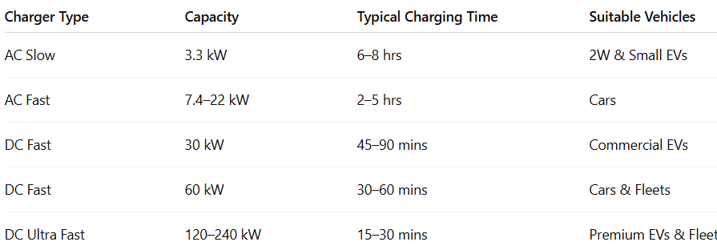
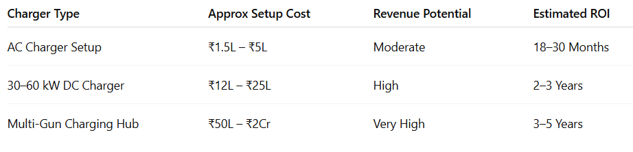
ALTARBYTE
Charger Type & ROI
ALTARBYTE T-HUB Hyderabad Telangana

Slide 8
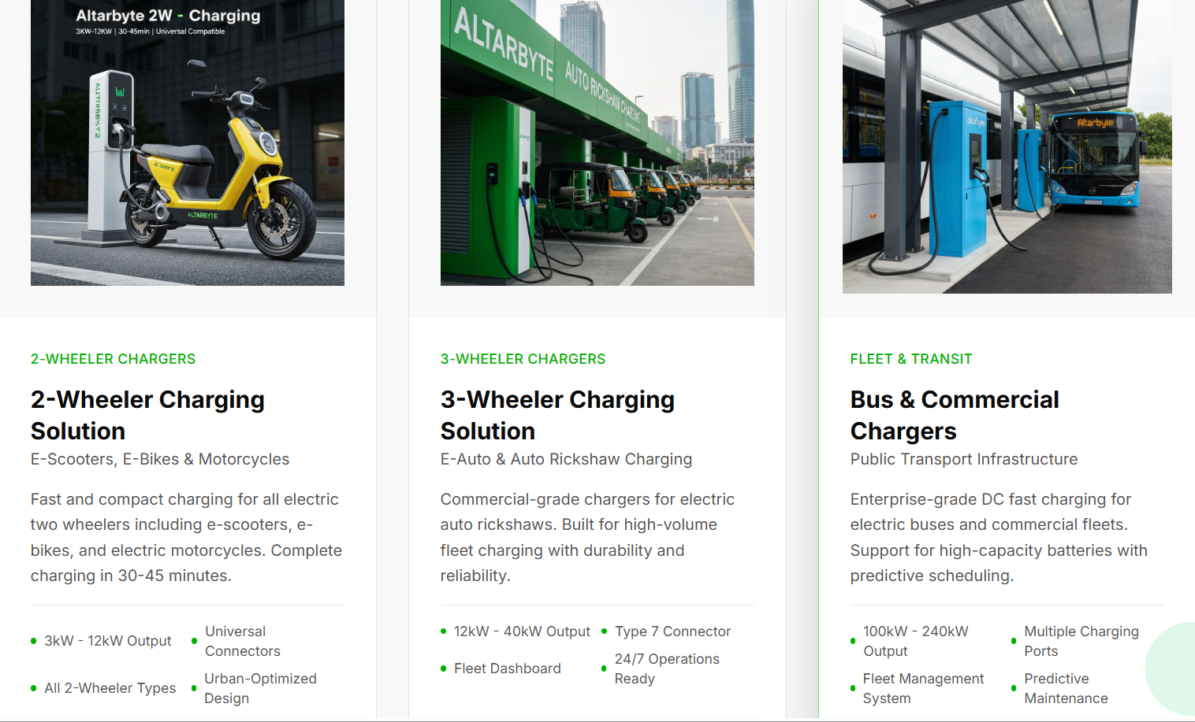
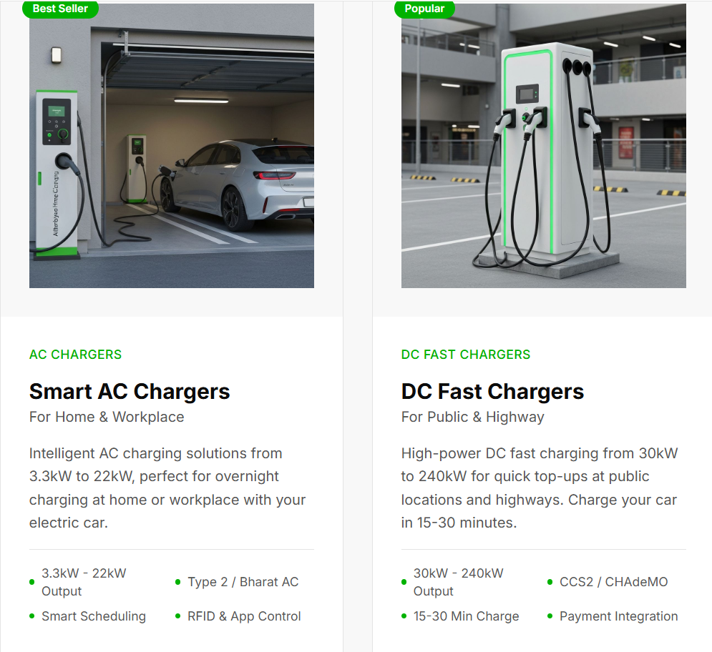
ALTARBYTE
ALTARBYTE T-HUB Hyderabad Telangana

Slide 9
Financials Current and Projections
Current Financials (2026) | 3-Year Growth Projections
• 2 Active EV Charging Projects Under Execution | • Revenue Growth Target: ₹1.2 Cr → ₹8–12 Cr
• Average Project Value: ₹45 Lakhs | • Expansion Across AP & Telangana Markets
• Current Order Book: ₹90 Lakhs | • 24+ EV Infrastructure Projects by FY 2028–29
• Net Profit Margin: 10–15% Per Project | • Projected Net Profit: ₹1–1.5 Cr Annually
• Monthly Operational Burn: ₹1.5 Lakhs | • Gross Margin Improvement to 20–25%
• Services Include EV Chargers, Electrical, Civil Works & AMC | • Focus on Fleet Charging, Highway Charging & AMC Revenue

Slide 10
Funding Requirements & Growth Plan and Projections
Funding Needs & Use of Funds | Investment Validation & Growth Outlook
• Seeking Pre-Seed Investment of ₹75 Lakhs – ₹1 Crore | • Strong EV adoption growth across Andhra Pradesh & Telangana markets
• Funds Allocation: Working Capital, Team Expansion, Marketing & Project Execution | • Government focus on EV ecosystem & net-zero carbon targets by 2030
• Planned Use: EV charger deployments, electrical & civil infrastructure scaling | • Increasing demand for commercial, fleet & highway charging infrastructure
• Current Strategic Ecosystem Includes OEM & Charging Network Partnerships | • Growing opportunity in apartments, fleets, petrol bunks & commercial spaces
• Investment Runway: 18–24 Months with target of 25–40 projects executed | • Target Revenue Milestone: ₹4–5 Cr annual revenue within next growth phase
• Proposed Valuation for Current Round: ₹8–10 Crore Pre-Money; Follow-on Series A planned after operational scale-up | • Long-term focus on scalable EV EPC + AMC recurring revenue business model

Slide 11
Current Equity Structure & Investment History
Equity Structure & Ownership | Investment History & Fund Utilization
• Current Founding Team Consists of 3 Owners & 5 Operational Employees | • Total Founder Investment Till Date: ₹10 Lakhs
• Founder & CEO Holds Majority Stake of 51% | • No External Investors or Institutional Funding Raised Yet
• Remaining 49% Equity Split Equally Between Other 2 Co-Founders | • Initial Capital Used for Office Setup, Infrastructure & Operations
• Founder-Led Decision Making with Lean Startup Structure | • Funds Utilized for Field Visits, Client Evaluations & Travel Expenses
• Future ESOP & Investor Pool Planned for Strategic Expansion | • Investments Also Supported Sales, Marketing & Business Development
• Equity Structure Designed to Maintain Founder Control & Long-Term Stability | • Current Funding Enabled Market Entry & Initial EV Infrastructure Projects

Slide 12
Exit Opportunities for Investors
Investor Exit Opportunities | Market Potential & Industry Outlook
• Investors can exit through future strategic acquisition by larger EV charging, energy or infrastructure companies | • EV adoption across AP & Telangana is rapidly increasing with strong government push towards sustainable mobility
• As the company scales, future institutional or strategic investors may acquire early-stage investor equity | • India’s target towards reduced carbon emissions and EV ecosystem expansion by 2030 creates long-term market opportunity
• Potential partnerships with OEMs, charging network operators and energy companies can create acquisition opportunities | • Increasing demand for highway, commercial and fleet charging infrastructure is driving strong sector growth
• Investors may also exit through secondary share sale during future growth funding rounds | • EV infrastructure is expected to become a core part of commercial real estate, fleets and urban mobility systems
• Long-term goal is to build a scalable EV infrastructure company with recurring AMC and operational revenues | • The market is still in early stages, providing strong potential for valuation growth over the next 5–7 years
• Based on future scale and market expansion, IPO can be considered as a long-term possibility | • Similar clean-tech and mobility infrastructure companies have seen strong investor interest globally and in India

